Slide 1

Anshuman
1901037
ANSHUMAN
1901037

Slide 2
A Case Study on Face Position Detection using ML Algorithms
Problem Definition :-
Predict the class level(i.e. Left side, right side or in-front) of the face More Details :: We are given the coordinates of various face’s part of the face (like eyes, nose, mouth etc) and by this, we have to predict the face direction either it is on left side or right side or infront.
Uses:-
Head pose estimation
Driving performance evaluation

Slide 3
Literature Survey 01
A Fast Face Detection Method for JPEG Image
By-The First Research Institute of Ministry of Public Security, Beijing, China
Face detection is a key technology of face recognition
According to analyzing the feature of face image, the combination of reconstruction the low resolution image in the compressed domain and face detection in the pixel domain method is proposed.
The proposed paper achieves higher detection speed and closely detection accuracy.

Slide 4
Literature Survey 02
Rapid Face Detection and Annotation with Loosely Face Geometry
By : Dept. of Computer Science and Applications Gandhigram Rural Institute - DU, INDIA
If someone is looking at inappropriate angle then what?
This paper focus on face detection with varying degree of face occlusion(hiding face).
This algorithm aims to automatically detect face components individually and it starts from mostly un-occluded face component called Nose.

Slide 5
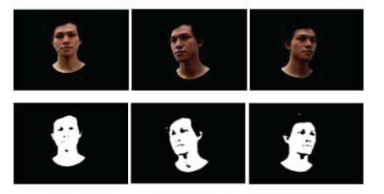
Literature Survey 03
Face Movement Detection Using Template Matching
By : Intelligence System Research Group Faculty of CS Universitas Sriwijaya Palembang, Indonesia
Purposed about face detection use template matching method on movement face.
This technique used is to determine the face region by separating the skin region to non-skin region.

Slide 6
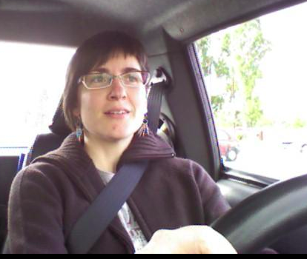
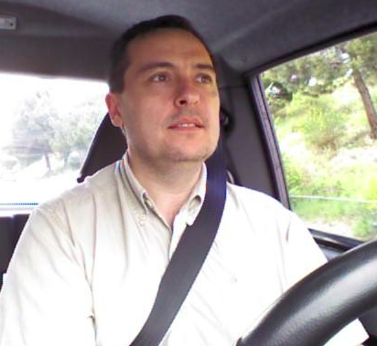

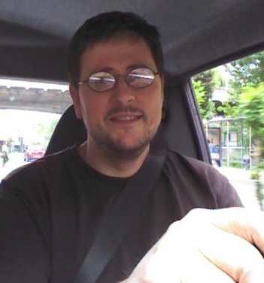
Dataset Analysis
A reduced feature set for driver head pose estimation.
The given dataset contains images(or frames) of men and women while driving car in real scenarios.
It is composed of 606 samples of 640×480 pixels each.
A set of labels assigning each image into 3 possible gaze direction classes are given.
Class 1 : The first class is the looking-right class and contains the head angles between -45º and -30º.
Class 2 : The second one is the frontal class and contains the head angles between -15º and 15º.
Class 3 : The last one is the looking-left class and con angles between 30ºtains the head and 45º.
Class 3
Class 3
Class 1
Class 2

Slide 7
Features Description
drivPoints.txt contains the ground truth in table's format, where the dataset have the follow information:
fileName :: Image's name
subject :: Person's ID number
imgNum :: Frame's number
label :: [0/1/2] (head pose class that corresponding to [lr/f/lf], respectively)
ang :: [-45, -30/ -15 0 15/ 30 15] (head pose angle)
[xF yF wF hF] :: face position
[xRE yRE] :: rigth eye position
[xLE yL] :: left eye position
[xN yN] :: Nose position
[xRM yRM] :: rigth corner of mouth
[xLM yLM] :: left corner of mouth
So these are the feature from which we have to give the output , wheather there is a face (belongs to class 0,1,2)or not

Slide 8
Result and Observation

Slide 9
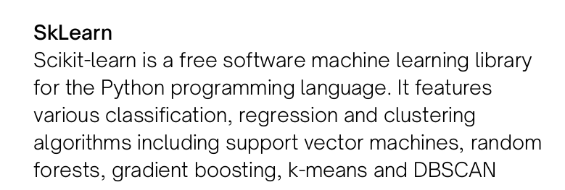
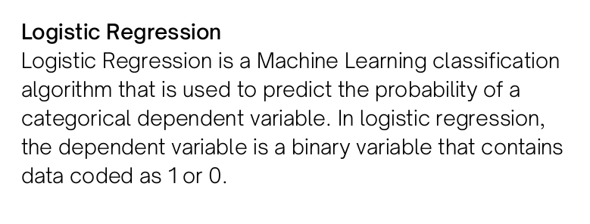
Multi-Class Logistic Regression using k-fold
Library Used :
Class Used :

Slide 10
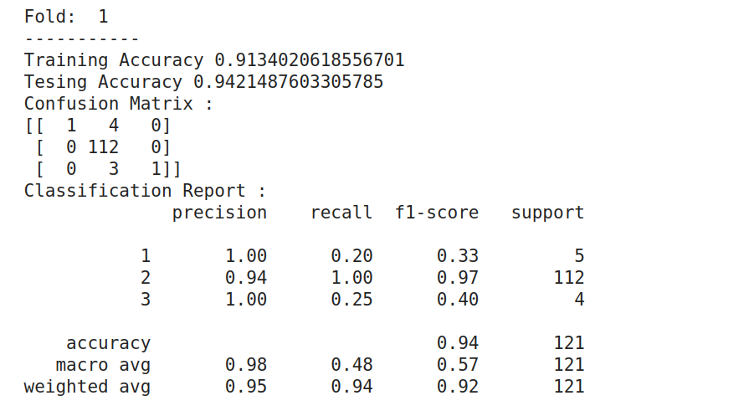


For Fold 1 : (getting best result)
Training Accuracy : 91.34%
Testing Accuracy : 94.21%
Average Precision : 0.98
Average Recall : 0.48
Average Training Accuracy : 0.9146
Average Testing Accuracy : 0.9124

Slide 11
2. Sigmoid (Logistic ) Neurons
Details of User-Define Function Used
Log Loss Function : Cost Function
Create Y Function : For particular class Y
Train-Model : For train the model
Accuracy : (TP + TN) / (TP + FP + TN + FN)
Precision : (TP) / (TP + FP)
Recall : (TP) / (TP + FN)
PrintMatrix : To show result

Slide 12
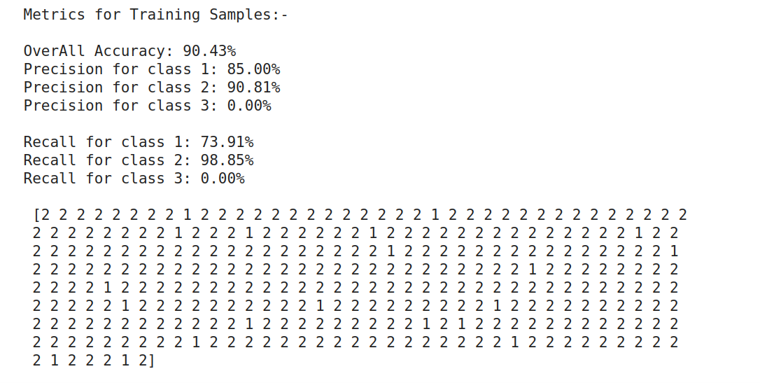
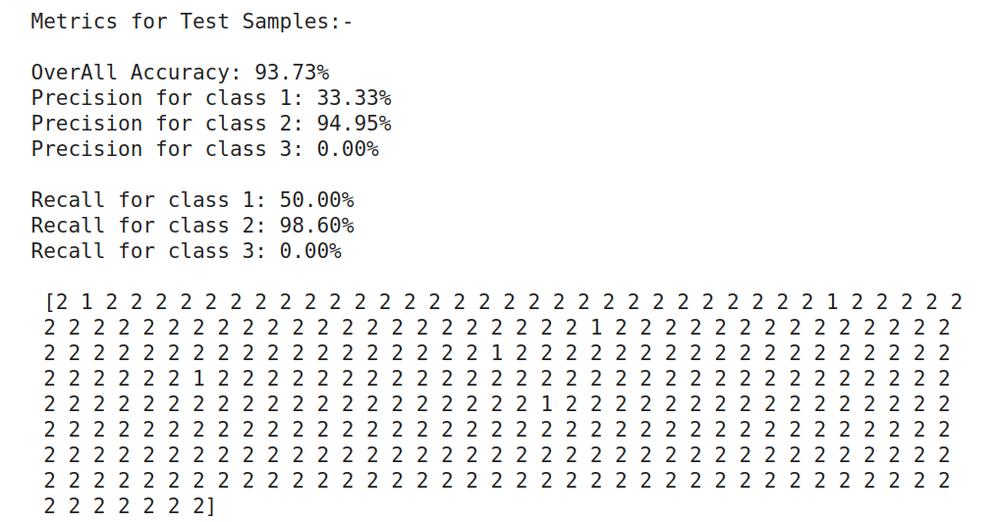
Training Sample
Final Accuracy : 90.43%
Average Precision : 58.33%
Average Precision : 57.21%
Test Sample
Final Accuracy : 93.73%
Average Precision : 42.33%
Average Precision : 49.61%

Slide 13
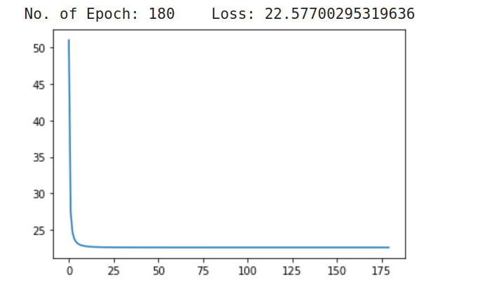
3. SLP
Observation : After around 180 epoch, values get saturated Best Hyperparameter founded Experimentally Error : e^-6
Alpha : 0.1

Slide 14
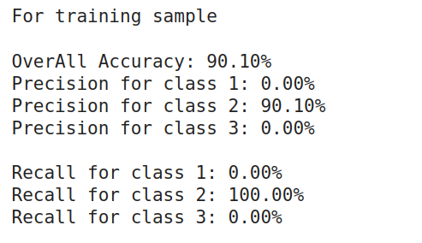
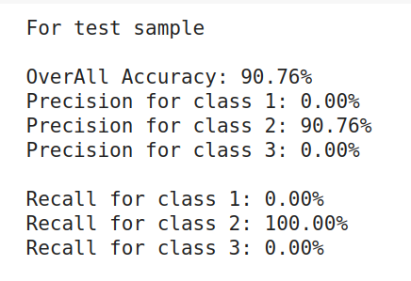
For Training Sample
OverAll Accuracy : 90.10%
For Test Sample
OverAll Accuracy : 90.76%

Slide 15
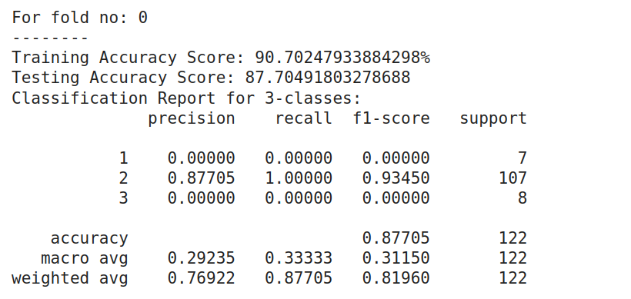


4. MLP
Using inbuilt function
For Fold 0 : (getting result)
Training Accuracy : 90.70%
Testing Accuracy : 87.70%
Max Precision : 0.877
Max Recall : 1.0

Slide 16
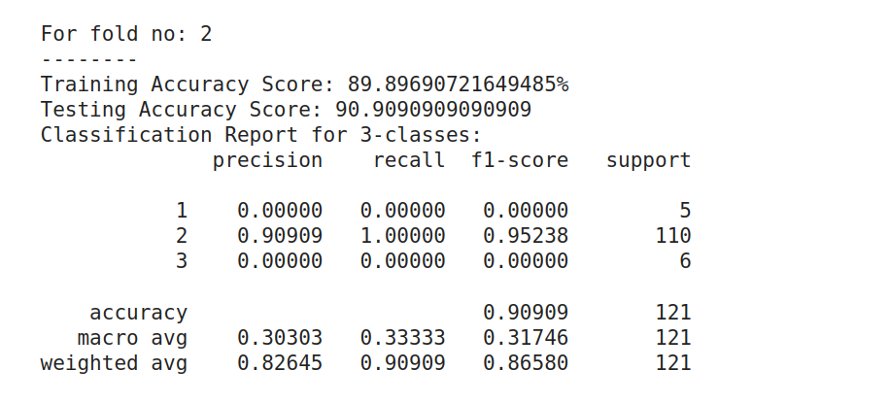
Getting best result for Fold 2
Training Accuracy : 89.89%
Testing Accuracy : 90.90%
Max Precision : 0.90909
Max Recall : 1.0
Average Training Accuracy 0.894642395641
Average Tesing Accuracy 0.89444657874466

Slide 17
Result Analysis and Conclusion
Comparing the result of all possible algorithm implemented in this project, Logistic Regression with K-fold perform better than other
As this is the classification problem and we have exact Math model for comparing the result
Our work is to just make proper decision boundaries and LR is suited best for those type of problem
Artificial neural network(ANN) use used for those problem where we don’t have exact math model
Best Training Accuracy : 91%
Best Testing Accuracy : 94%

Slide 18

References
https://ieeexplore.ieee.org/search/searchresult.jsp?newsearch=true&queryText=face%20detection%20using%20ml%20algorithm
https://scikit-learn.org/stable/modules/generated/sklearn.model_selection.KFold.html
https://ieeexplore.ieee.org/abstract/document/840634/
https://pythonhosted.org/facereclib/references.html
https://www.ini.rub.de/PEOPLE/wiskott/Bibliographies/FaceRecognition.html
https://scikit-learn.org/
https://cs231n.github.io/python-numpy-tutorial/
https://github.com/ageitgey/face_recognition
THANK YOU

